Slide 1
Exploratory Data Analysis of Industry Dataset
Prepared using Python, Pandas, Matplotlib and Seaborn

Slide 2
Introduction
EDA helps understand datasets using statistics and visualization.
Dataset contains 15,000 rows and 12 columns.
Project focuses on industry performance analysis.

Slide 3
Dataset Features
id
company_name
industry
country
employee_count
annual_revenue_million
profit_margin_percent
customer_count
market_rating
created_date
region

Slide 4
Libraries Used
NumPy for numerical operations
Pandas for data manipulation
Matplotlib for plotting
Seaborn for statistical visualizations

Slide 5
Univariate Analysis
Analyzed one variable at a time
Used histograms and descriptive statistics
Calculated mean, median, skewness and kurtosis

Slide 6
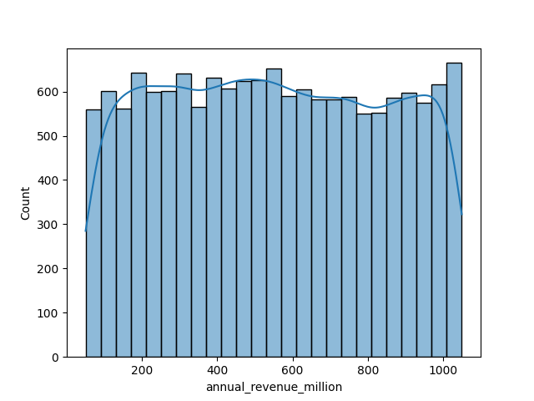
Histogram

Slide 7
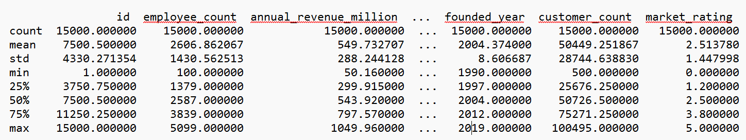
Descriptive statistics

Slide 8
Outlier Detection
Boxplot method used
Z-score method used for statistical outlier detection

Slide 9
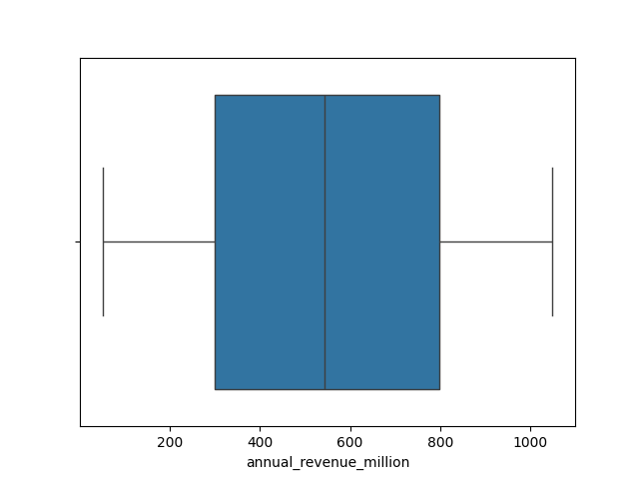
Revenue Boxplot

Slide 10
Bivariate Analysis and Correlation Analysis
Studied relationships between variables
Employee count vs revenue
Customer count vs revenue
Generated correlation matrix
Heatmap visualization created
Strong positive relation between employee count and revenue

Slide 11
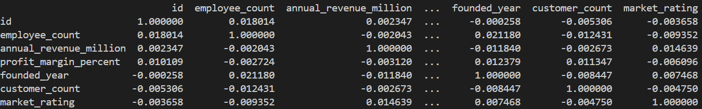
Correlation between each variables

Slide 12
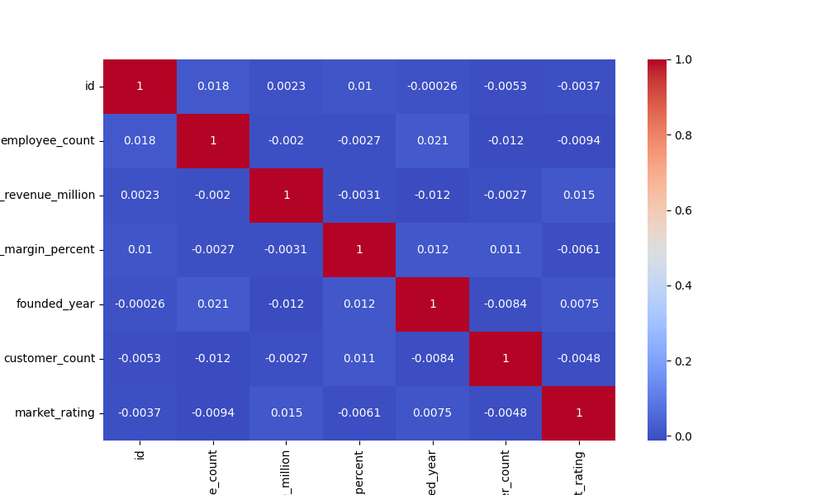
Employee count vs Revenue

Slide 13
Multivariate Analysis
Industry × Revenue × Employee Count
Region × Profit Margin × Market Rating
Country × Revenue × Customer Count

Slide 14
Key Findings
Technology companies generated highest revenue
Retail sector handled largest customer base
Revenue distribution was positively skewed
Large enterprises contributed major revenue

Slide 15
Conclusion
EDA successfully performed using Python
Statistical analysis generated business insights
Useful for market analysis and strategic decisions

